Slide 1
Light direction
Julia uses a lamp to light the inside of a box.
She is thinking about how light moves from the lamp.
Lamp

Slide 2
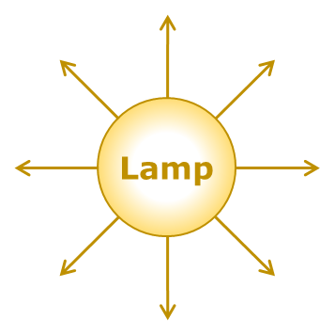
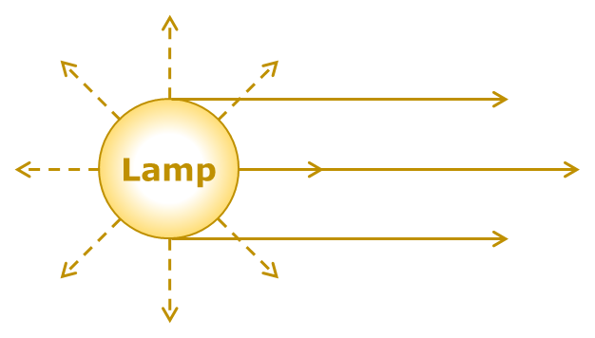
Light direction
How does light move from the lamp?
A |  | All towards the hole
B |  | Equally in all directions
C |  | Mostly towards the hole

